Slide 1
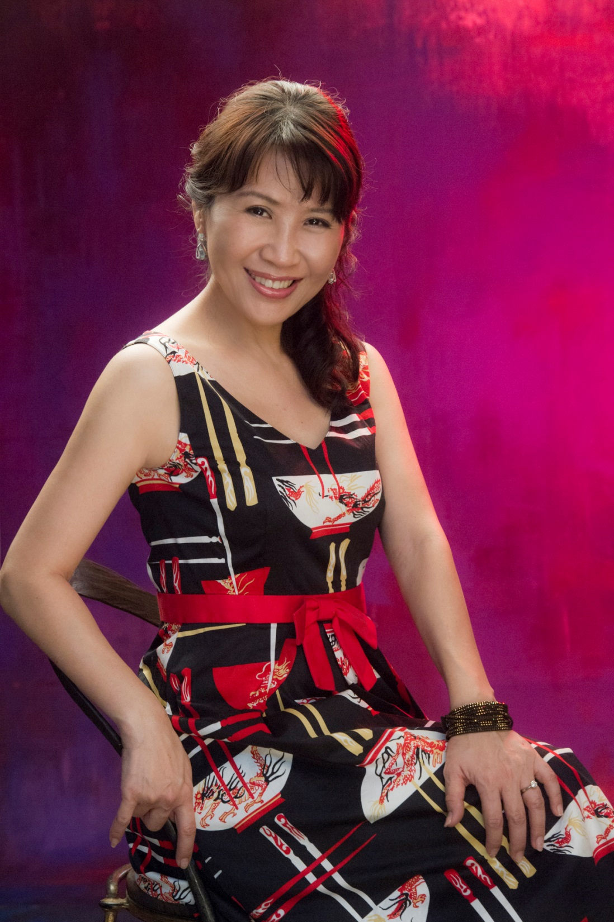
組織建構三部曲
Recruiting and Activation
Beatrice Li 理筱霞
副總裁級
Field Vice-President
四個佣金週期共賺取HK$276,000
HK$276,000 in 4 Commission weeks
本簡報中提到的收入等級純屬舉例說明，無意代表美安香港超連鎖店主的一般收入，也無意表示任何超連鎖店主皆可賺取同等收入。美安香港超連鎖店主的成功與否，取決於其在發展事業時的努力、才能與投入程度。The income levels mentioned in the following presentation are for illustration purposes only. They are not intended to represent the income of a typical Market Hong Kong UnFranchise Owner, nor are they intended to represent that any given Independent UnFranchise Owner will earn income in that amount. The success of any Market Hong Kong Independent UnFranchise Owner will depend upon the amount of hard work, talent, and dedication which he or she devotes to building his or her Market Hong Kong Business.

Slide 2
理筱霞
台北醫學大學藥學系
藥品公司總經理
副總裁級
(每四週HK$276,000)
百萬美金俱樂部成員

Slide 3

Recruiting

Slide 4

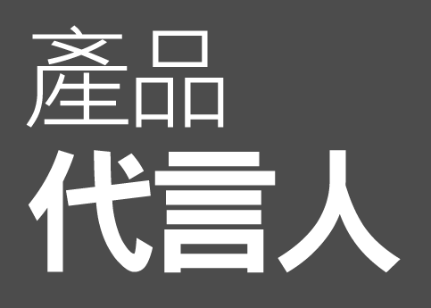
®
®
Product spokesperson

Slide 5
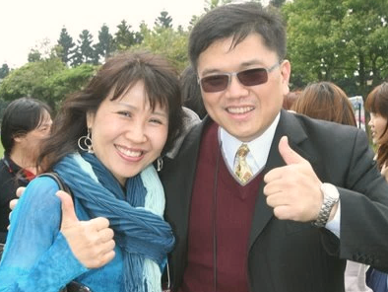

Slide 6

Grasp the opportunity to recruiting from sales

Slide 7
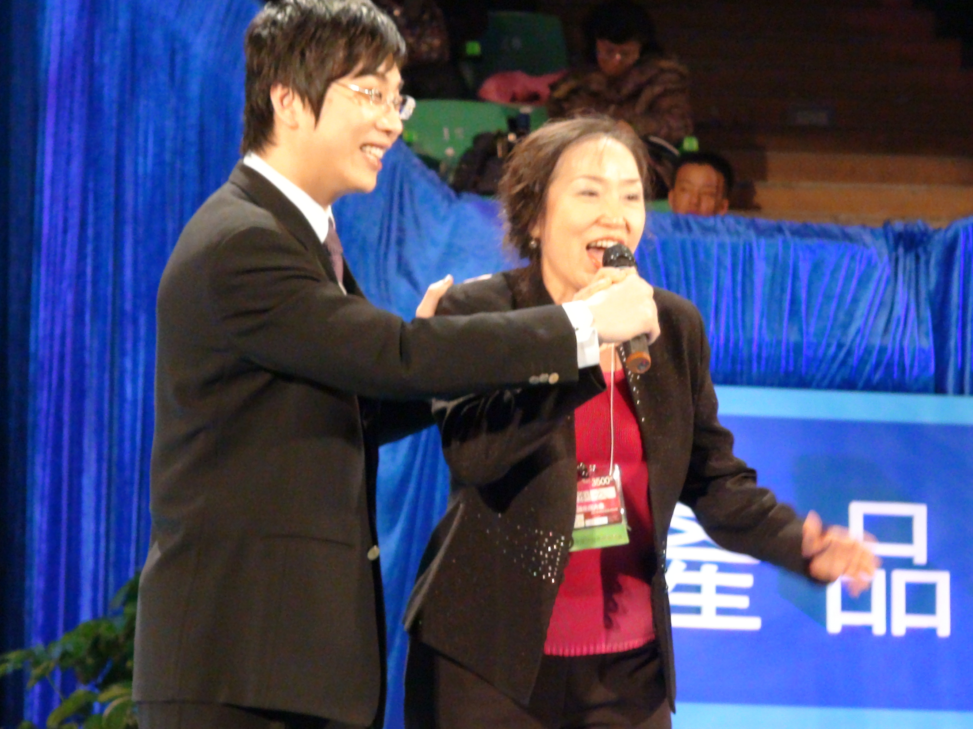

Slide 8

Products recruit
Professionals

Slide 9
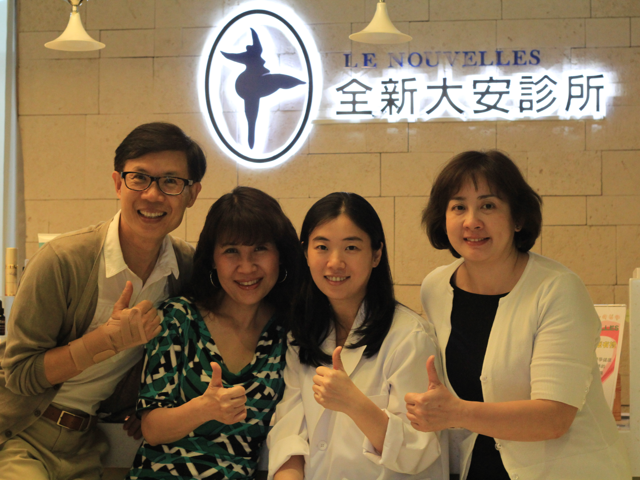

Slide 10
超連鎖™店主的類型
Types of UnFranchise™ Owner
Waiting
等待觀望型
Stable
踏實穩健型
Go Now
積極主動型

Slide 11

Notes:
11
11

Slide 12


超連鎖™店主(UFO)計劃
從超連鎖™管理系統下載
【超連鎖店主™計劃】
下載 > 管理 > 閲讀文件
點選【超連鎖™店主計劃】
Download 【Master UFO Program】from UFMS
Downloads>Administration>View Documents
Click 【Master UFO Program】
財務成功的構架
成為專業人士，掌握成功五要訣
Notes:
12
12
12

Slide 13
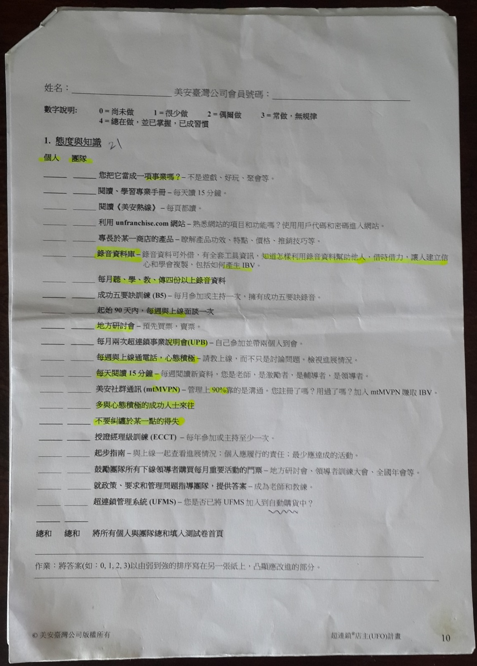

Slide 14
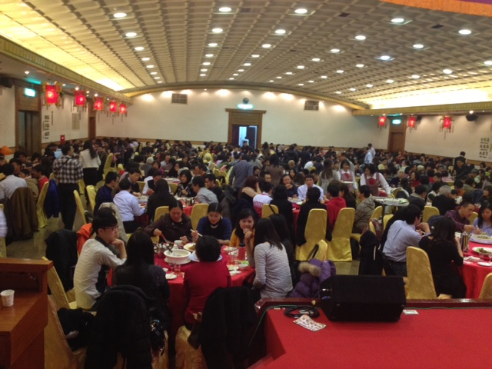

Slide 15
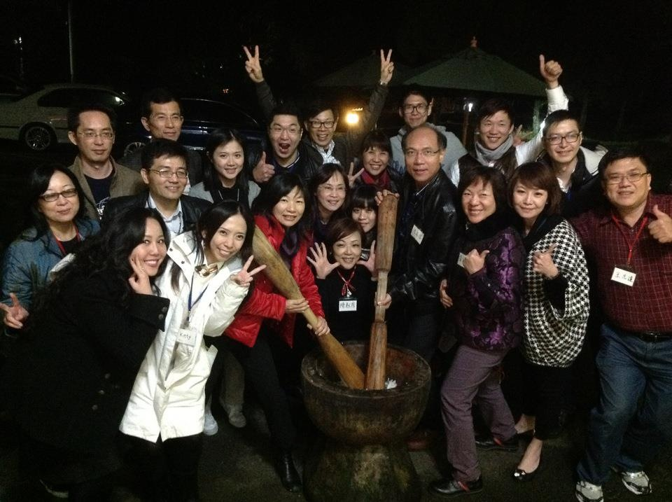

Slide 16
跟進4件事
Follow up actions
大量用產品
Use huge amount of products
聆聽錄音CD
Listen to the audio CD
有能力說明
分紅計畫
Has an ability to explain the bonus plan
買票賣票
Ticket selling

Slide 17
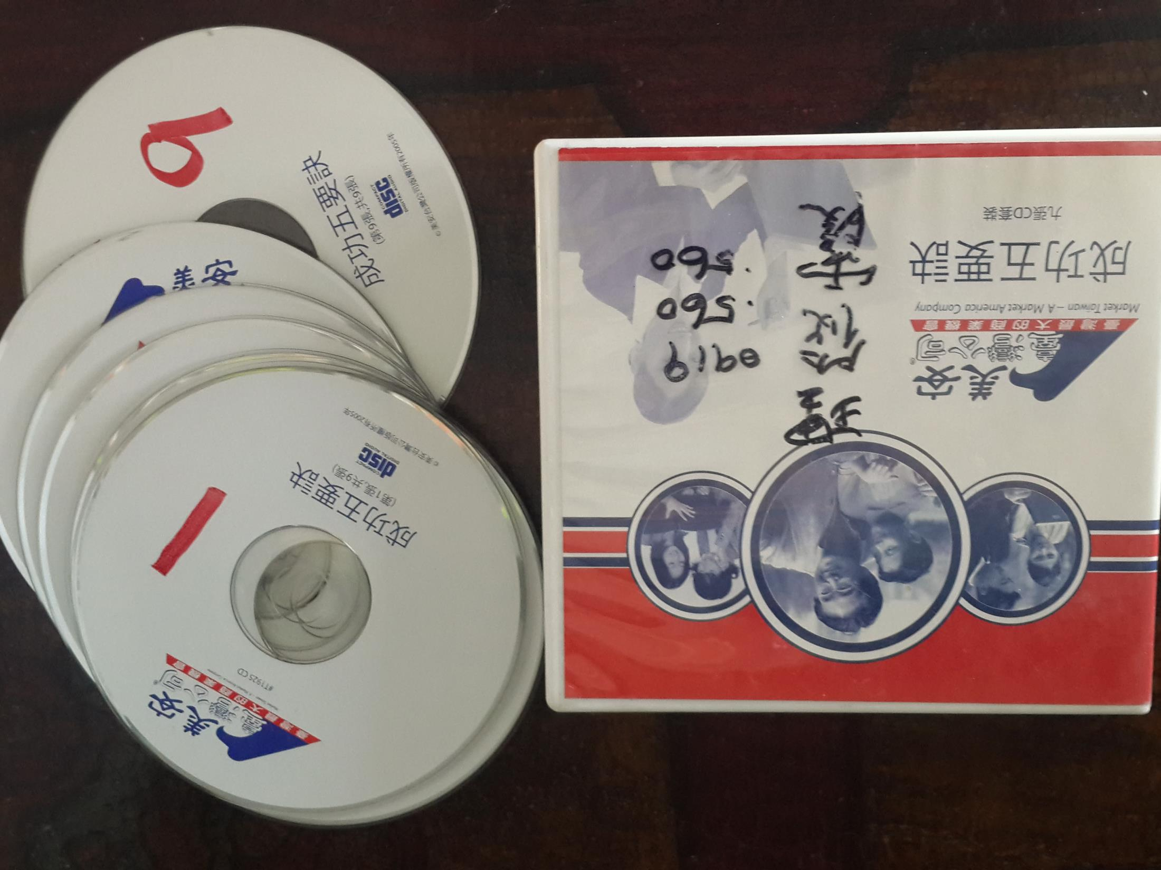

Slide 18
跟隨系統Follow the System
票
Ticket
美安精神
MA Spirit
進入教育訓練系統
Into the education and training system

Slide 19
人生無處不「勉強」
Life is full of “reluctance”
人生的真相就是「勉強別人」！而成功的人，就是很會勉強別人的人。
能力則是用勉強別人來衡量，不會勉強別人的人，就是沒有能力的人。
“Force others” is the truth of life! The most successful people who know how to force their minds on others.
Ability measures with the skill of forcing others, only incompetent dose not force others.

Slide 20
「勉強」用各種不同的形式存在。最粗魯而直接的勉強叫命令；文雅、含蓄的勉強叫溝通；用道理勉強叫說服；詭詐的勉強叫欺騙；用好處勉強叫引誘；炫惑的勉強叫廣告；不斷的勉強叫鍥兒不捨。
「勉強」是一切事物的原動力，任何工作、任何任務，都需要不斷勉強自己、勉強別人，才能夠完成。
“Reluctance” exists in different forms. Order: the rude and direct reluctant; communication: the polite and implicit reluctant; persuasion: reluctant with reasons; cheat: the dishonest reluctant; lure: reluctant with advantages; advertisement: reluctant with exaggerated words; never give up: reluctant continuously.
“Reluctance" is the original power of things, we need to constantly force ourselves, others to complete any kind of work and task.
－【自慢】何飛鵬
Fei-Peng, Ho 【Pridea Boast】

Slide 21
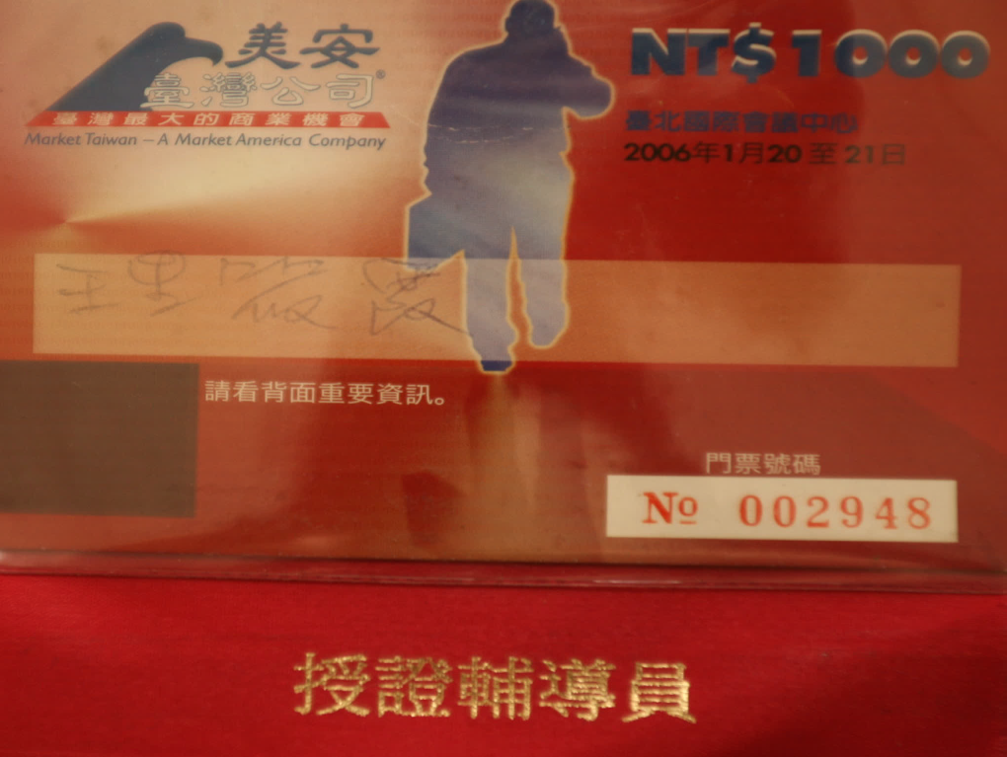

Slide 22

能量會彼此流動
夢想會互相啟發
聯手力量,超乎想像!
Energy will flow from each other
Dreams will inspire each other
Joint forces beyond imagination!

Slide 23



